Slide 1
History of Journalism

Slide 2
59 BC
The first newspapers
Over 2000 years ago, Ancient Romans hand wrote news sheets that were posted around the city.

Slide 3
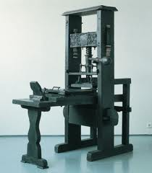
1439
Johannes Gutenberg develops printing press
Whoa! Sharing written information just became WAY easier!

Slide 4
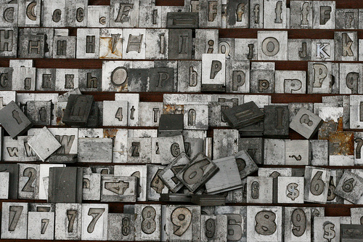
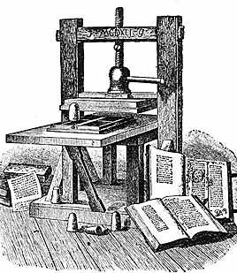
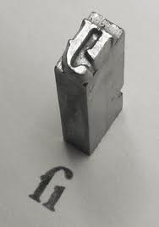

Slide 5
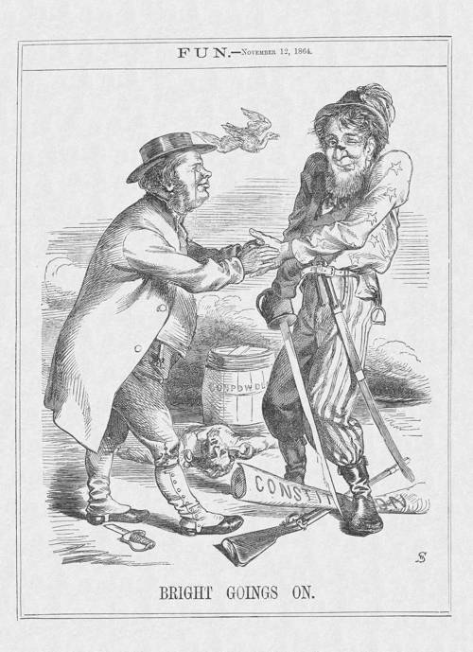
1500s
People start sharing criticisms through writing
Members of the press criticize and make fun of the king. Before this time, most citizens would never dream of talking out against the government .

Slide 6
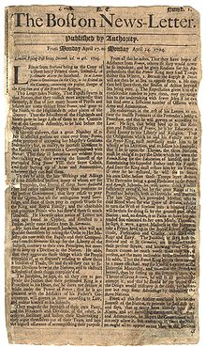
1704
First American newspaper
The Boston News-Letter was one page long and was published once each week.

Slide 7
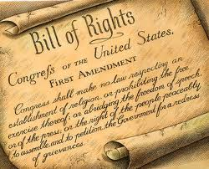
1791
First Amendment
The Bill of Rights is the first 10 amendments to the United States constitution.
Journalists see the First Amendment as VERY, VERY IMPORTANT because it guarantees freedom of the press.

Slide 8
1791
First Amendment
Congress shall make no law respecting an establishment of religion, or prohibiting the free exercise thereof; or abridging the freedom of speech, or of the press; or the right of the people peaceably to assemble, and to petition the Government for a redress of grievances

Slide 9
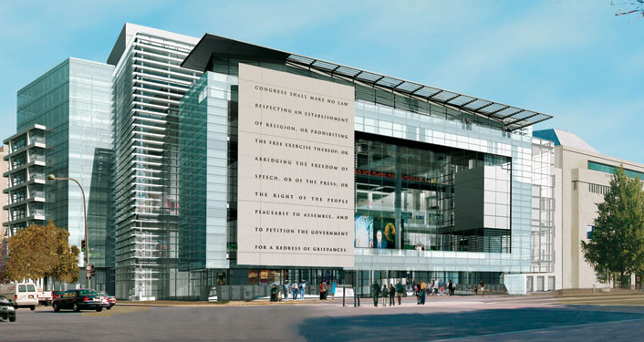
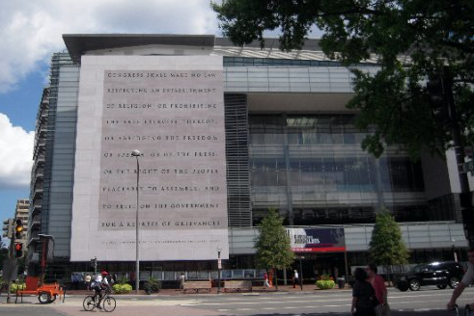

Slide 10
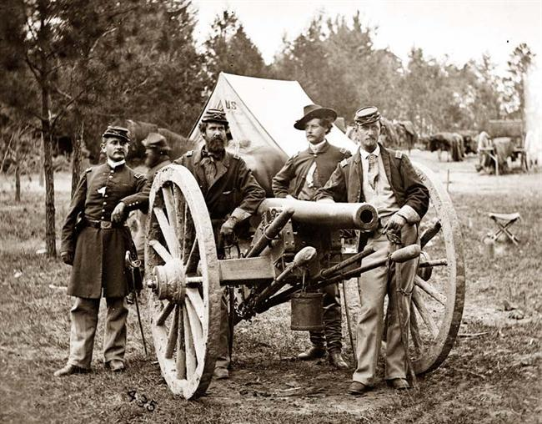
1860s
Photos in the news
During the Civil War, a new invention called the camera showed citizens the news like never before.

Slide 11
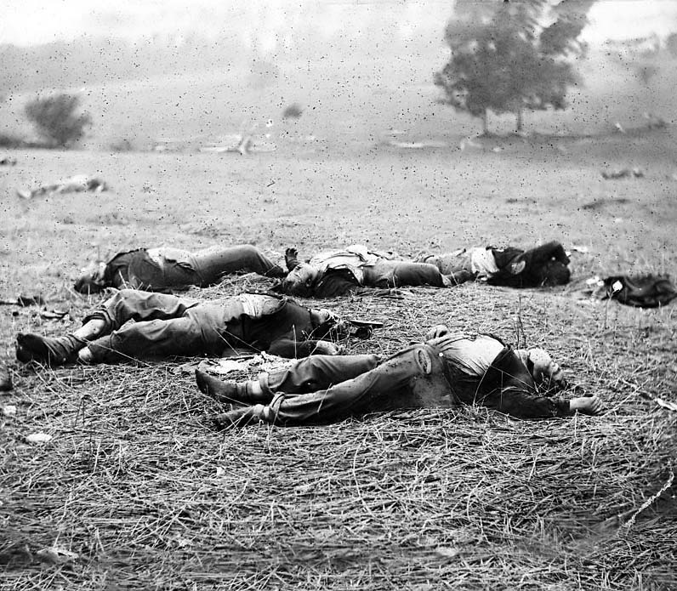

Slide 12
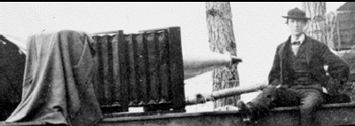
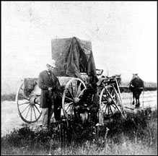
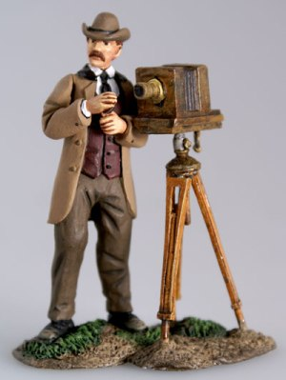

Slide 13
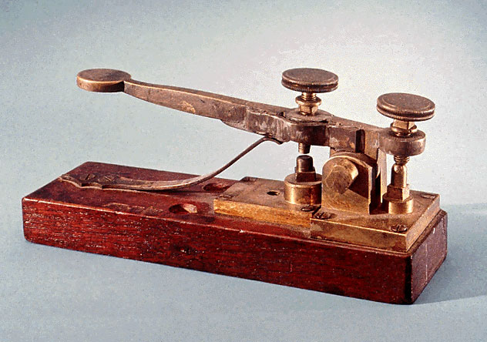
1860s
Invention of the telegraph
News picked up speed! Reporters sent encoded news back to their papers as it was happening.

Slide 14
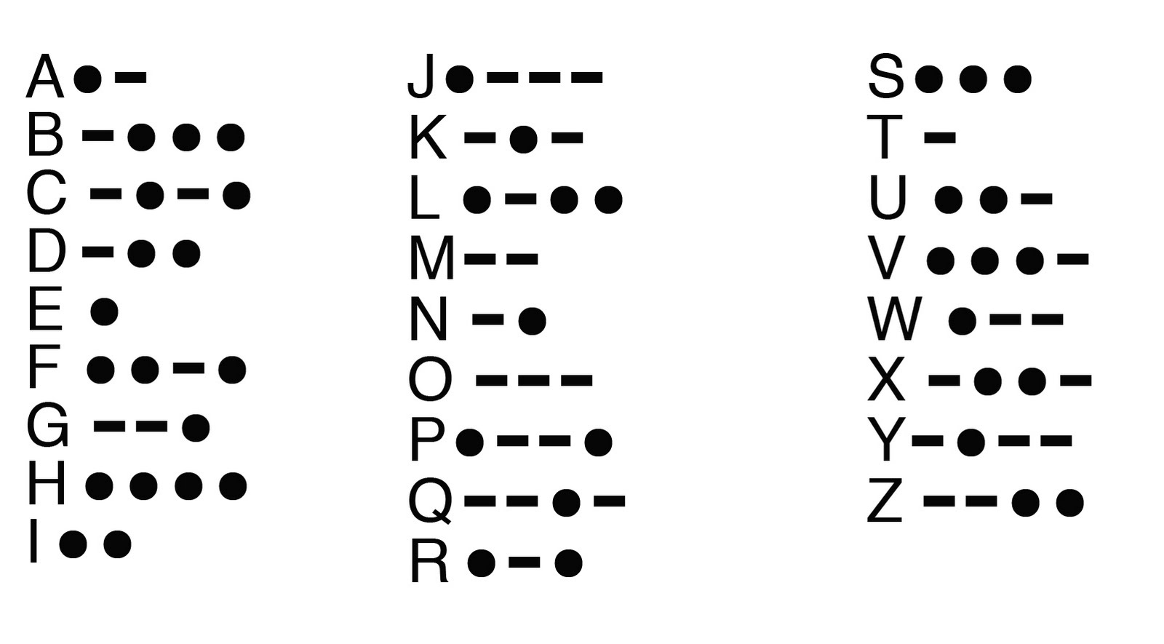
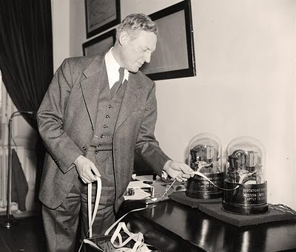
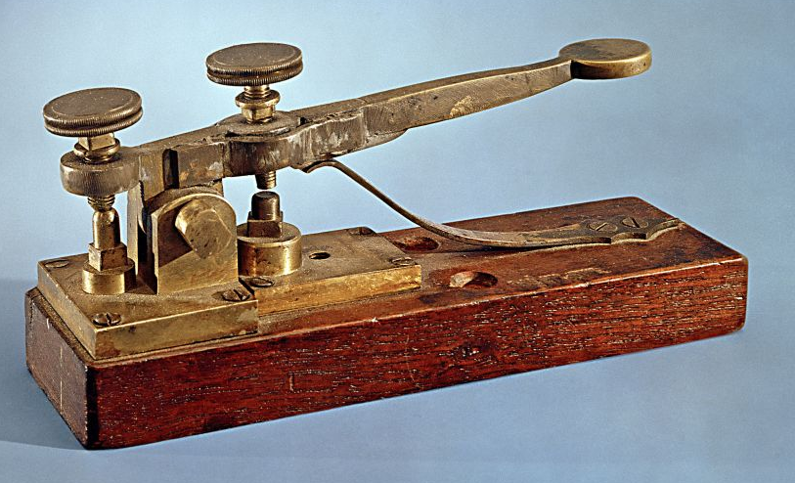

Slide 15
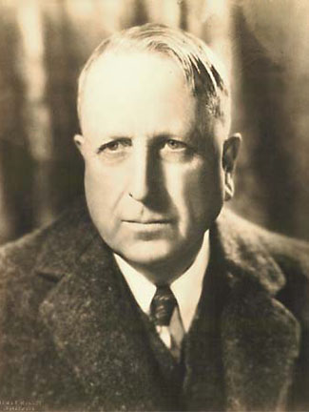
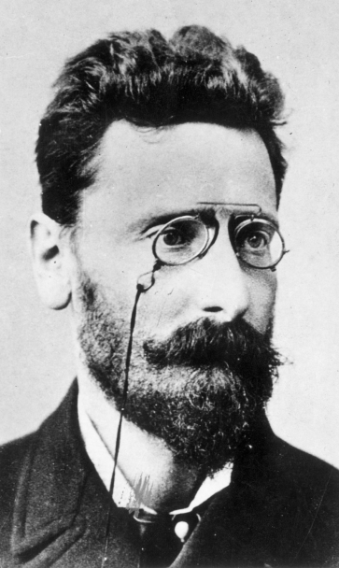
Early 1900s
Daily newspapers
Most big cities have a daily newspaper.
Famous newspaper publishers William Randolph Hearst and Joseph Pulitzer try to win readers with wild stories.

Slide 16
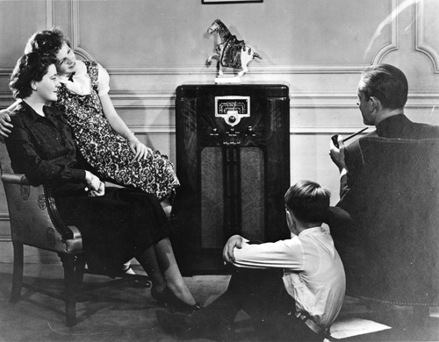
1920s – 1940s
Radio
Families gather around the radio to hear the day’s news.

Slide 17
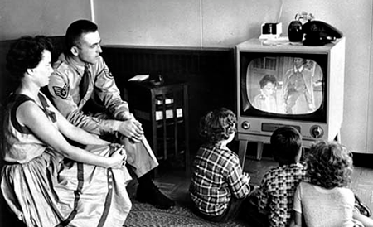
1950s – 1970s
Early TV news
Less than 1 percent of households owned a television in 1948. By 1970, almost 90 percent of households had at least one television.

Slide 18
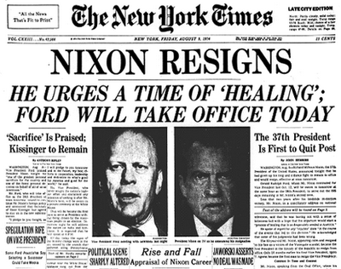
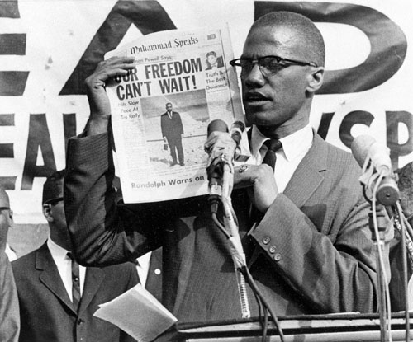
1950s – 1970s
Journalists investigate stories that change history
Because of the hard work of journalists, American history will forever be changed.

Slide 19
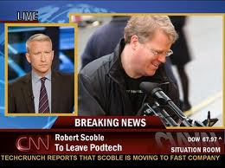
1980
CNN
Cable News Network, or CNN, makes news available 24 hours a day. This changes news forever.

Slide 20
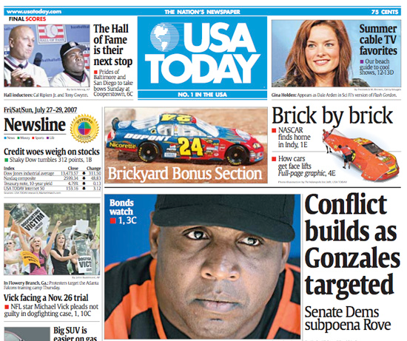
1982
USA Today
America’s first and only national daily newspaper starts publication.

Slide 21
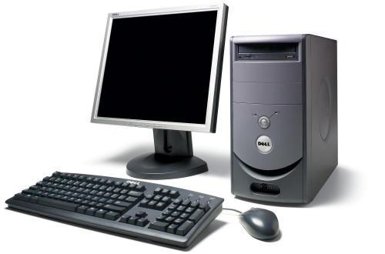
1990s – 2000s
Internet
News becomes instant.

Slide 22
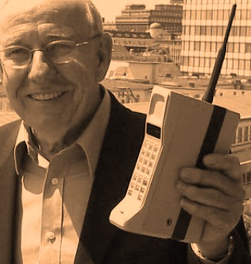
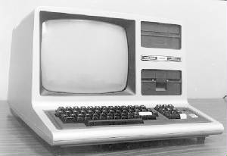
Remember this?

Slide 23
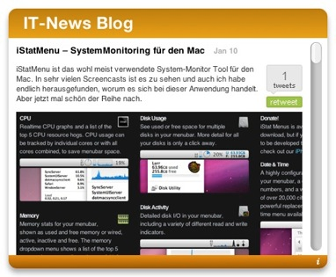
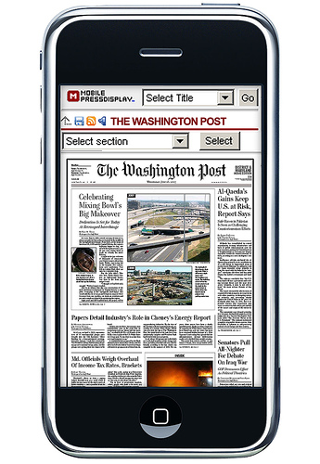
Present day
News never stops.
News is information.
News is knowledge.
News is freedom.

